Slide 1
Regulation of the Cell Cycle & Cancer
Chapter 11 (p. 206-213)
Chapter 12 (p.228-243)
Chapter 18.3 (p.373-377)

Slide 2
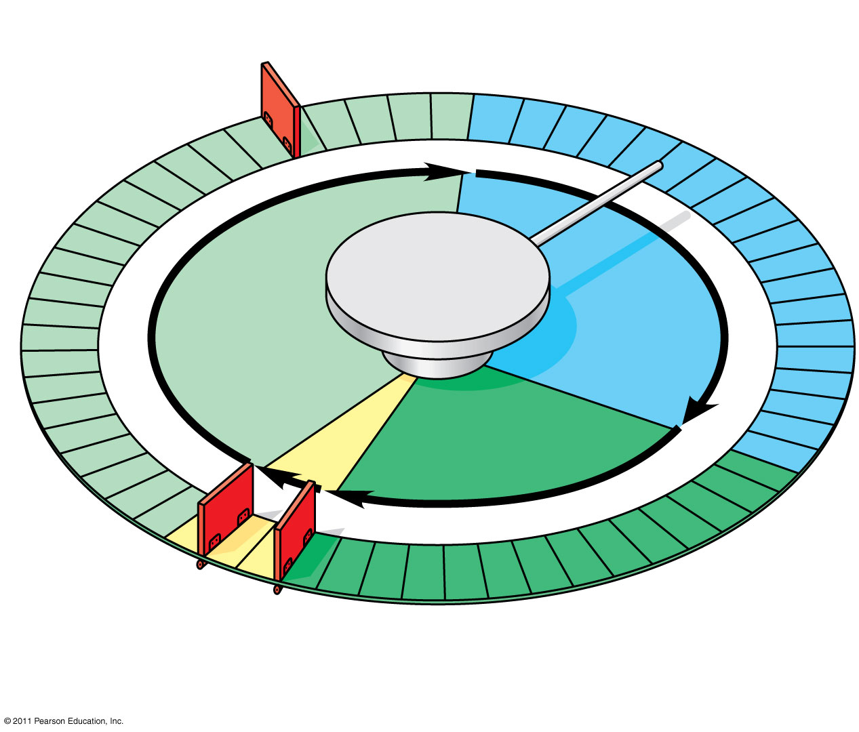
Figure 12.15
G₁ checkpoint
Control system
S
G₁
M
G₂
M checkpoint
G₂ checkpoint
Notes:
Figure 12.15 Mechanical analogy for the cell cycle control system.

Slide 3
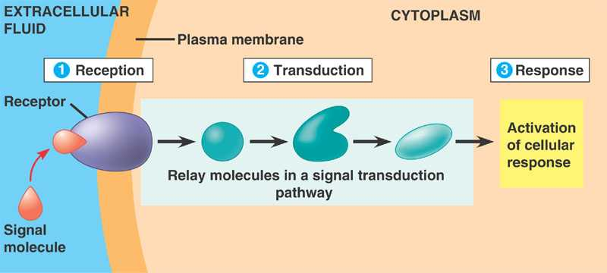
External Regulators
Growth Factors
Molecules that bind to surface receptor proteins
Stimulate cell division

Slide 4
External Regulators
Cell-Cell Recognition
Surface proteins in direct contact
Inhibits cell division

Slide 5
Internal Regulators
CDKs
Enzymes that “activate” other proteins by attaching a phosphate group
Always present in cell
Cyclins
Proteins that bind to CDKs
Fluctuates throughout cell cycle
Concentration
Type
Stimulate cell cycle when together!

Slide 6
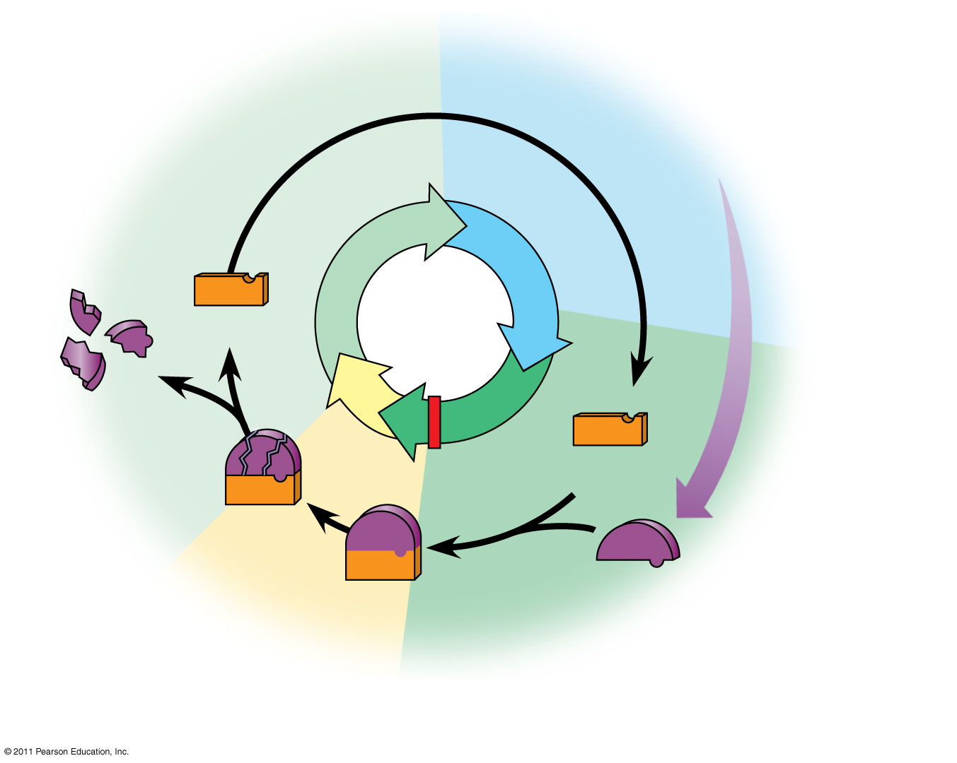
Figure 12.17b
G₁
S
Cdk
Cyclin accumulation
Degraded cyclin
M
G₂
G₂ checkpoint
Cdk
Cyclin is degraded
MPF
Cyclin
(b) Molecular mechanisms that help regulate the cell cycle
Notes:
Figure 12.17 Molecular control of the cell cycle at the G₂ checkpoint.

Slide 7
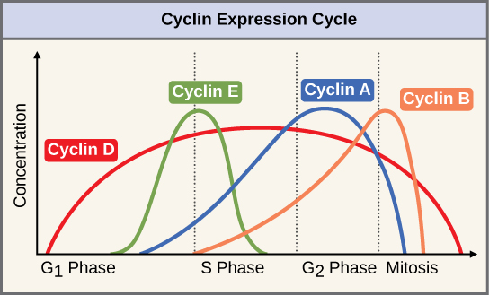

Slide 8
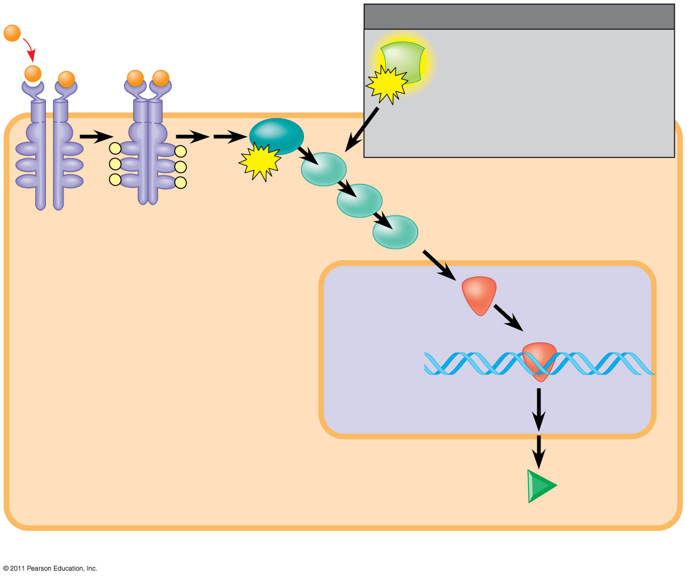

Slide 9
Internal Regulators
P53 & BRCA1
MAD
Stalls cell from progressing to next phase
DNA can be repaired
If damage cannot be fixed
Apoptosis
Prevents cell from progressing to anaphase when chromosomes are not properly attached to spindle fibers
Inhibit cell cycle!

Slide 10
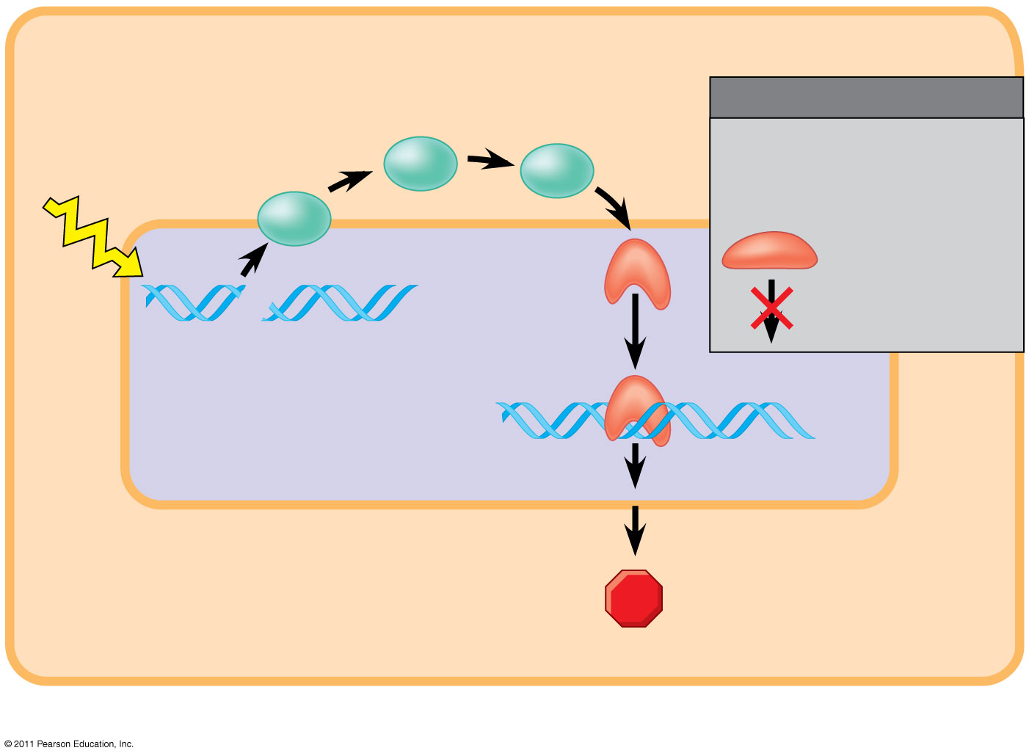

Slide 11
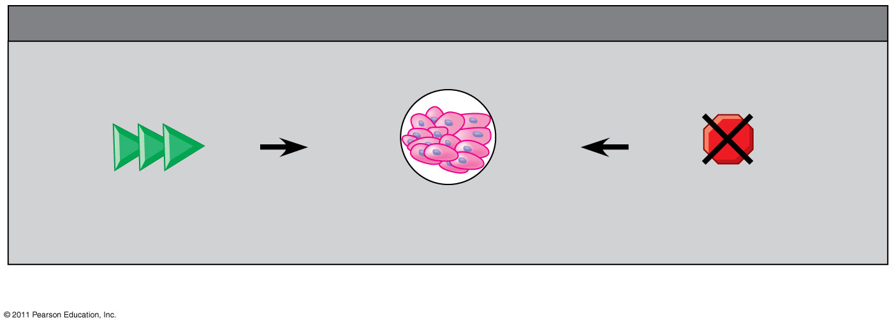
Figure 18.24c
EFFECTS OF MUTATIONS
Protein overexpressed
Protein absent
(c) Effects of mutations
Notes:
Figure 18.24 Signaling pathways that regulate cell division.

Slide 12
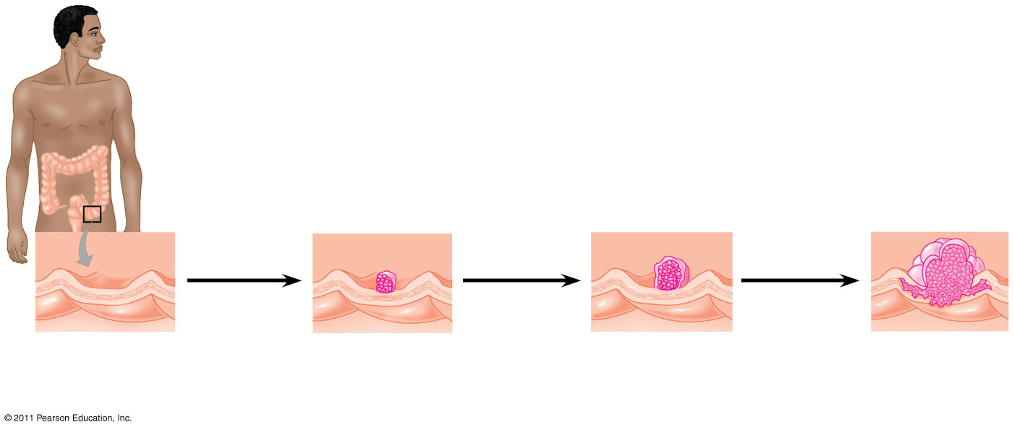
Figure 18.25
Colon
1
Loss of tumor- suppressor gene APC (or other)
4
Loss of tumor- suppressor gene p53
2
Activation of ras oncogene
3
5
Colon wall
Loss of tumor- suppressor gene DCC
Additional mutations
Normal colon epithelial cells
Small benign growth (polyp)
Larger benign growth (adenoma)
Malignant tumor (carcinoma)
Notes:
Figure 18.25 A multistep model for the development of colorectal cancer.

